Slide 1
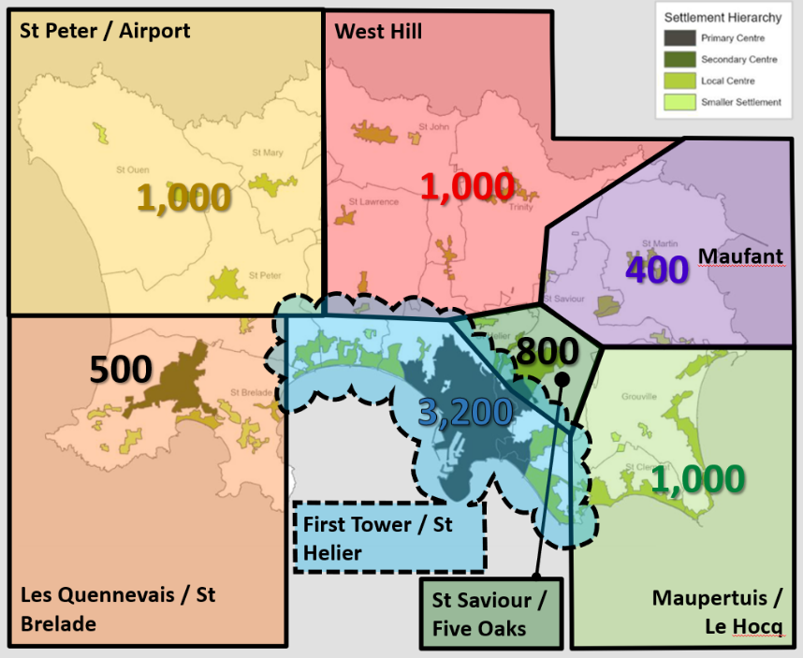
Liquid Waste Capital Delivery
Key Infrastructure Projects
03 September 2026 Ministerial Briefing
Northern Sewer Upgrades Phases 1a, 1b & 1c

Slide 2
Strategic Context
Housing Growth and Infrastructure Need
Bridging Island Plan aims to deliver approximately 4,000 homes.
Existing sewer infrastructure lacks capacity to accommodate future development.
Conclusion: Network upgrades are essential to unlock planned housing delivery.

Slide 3
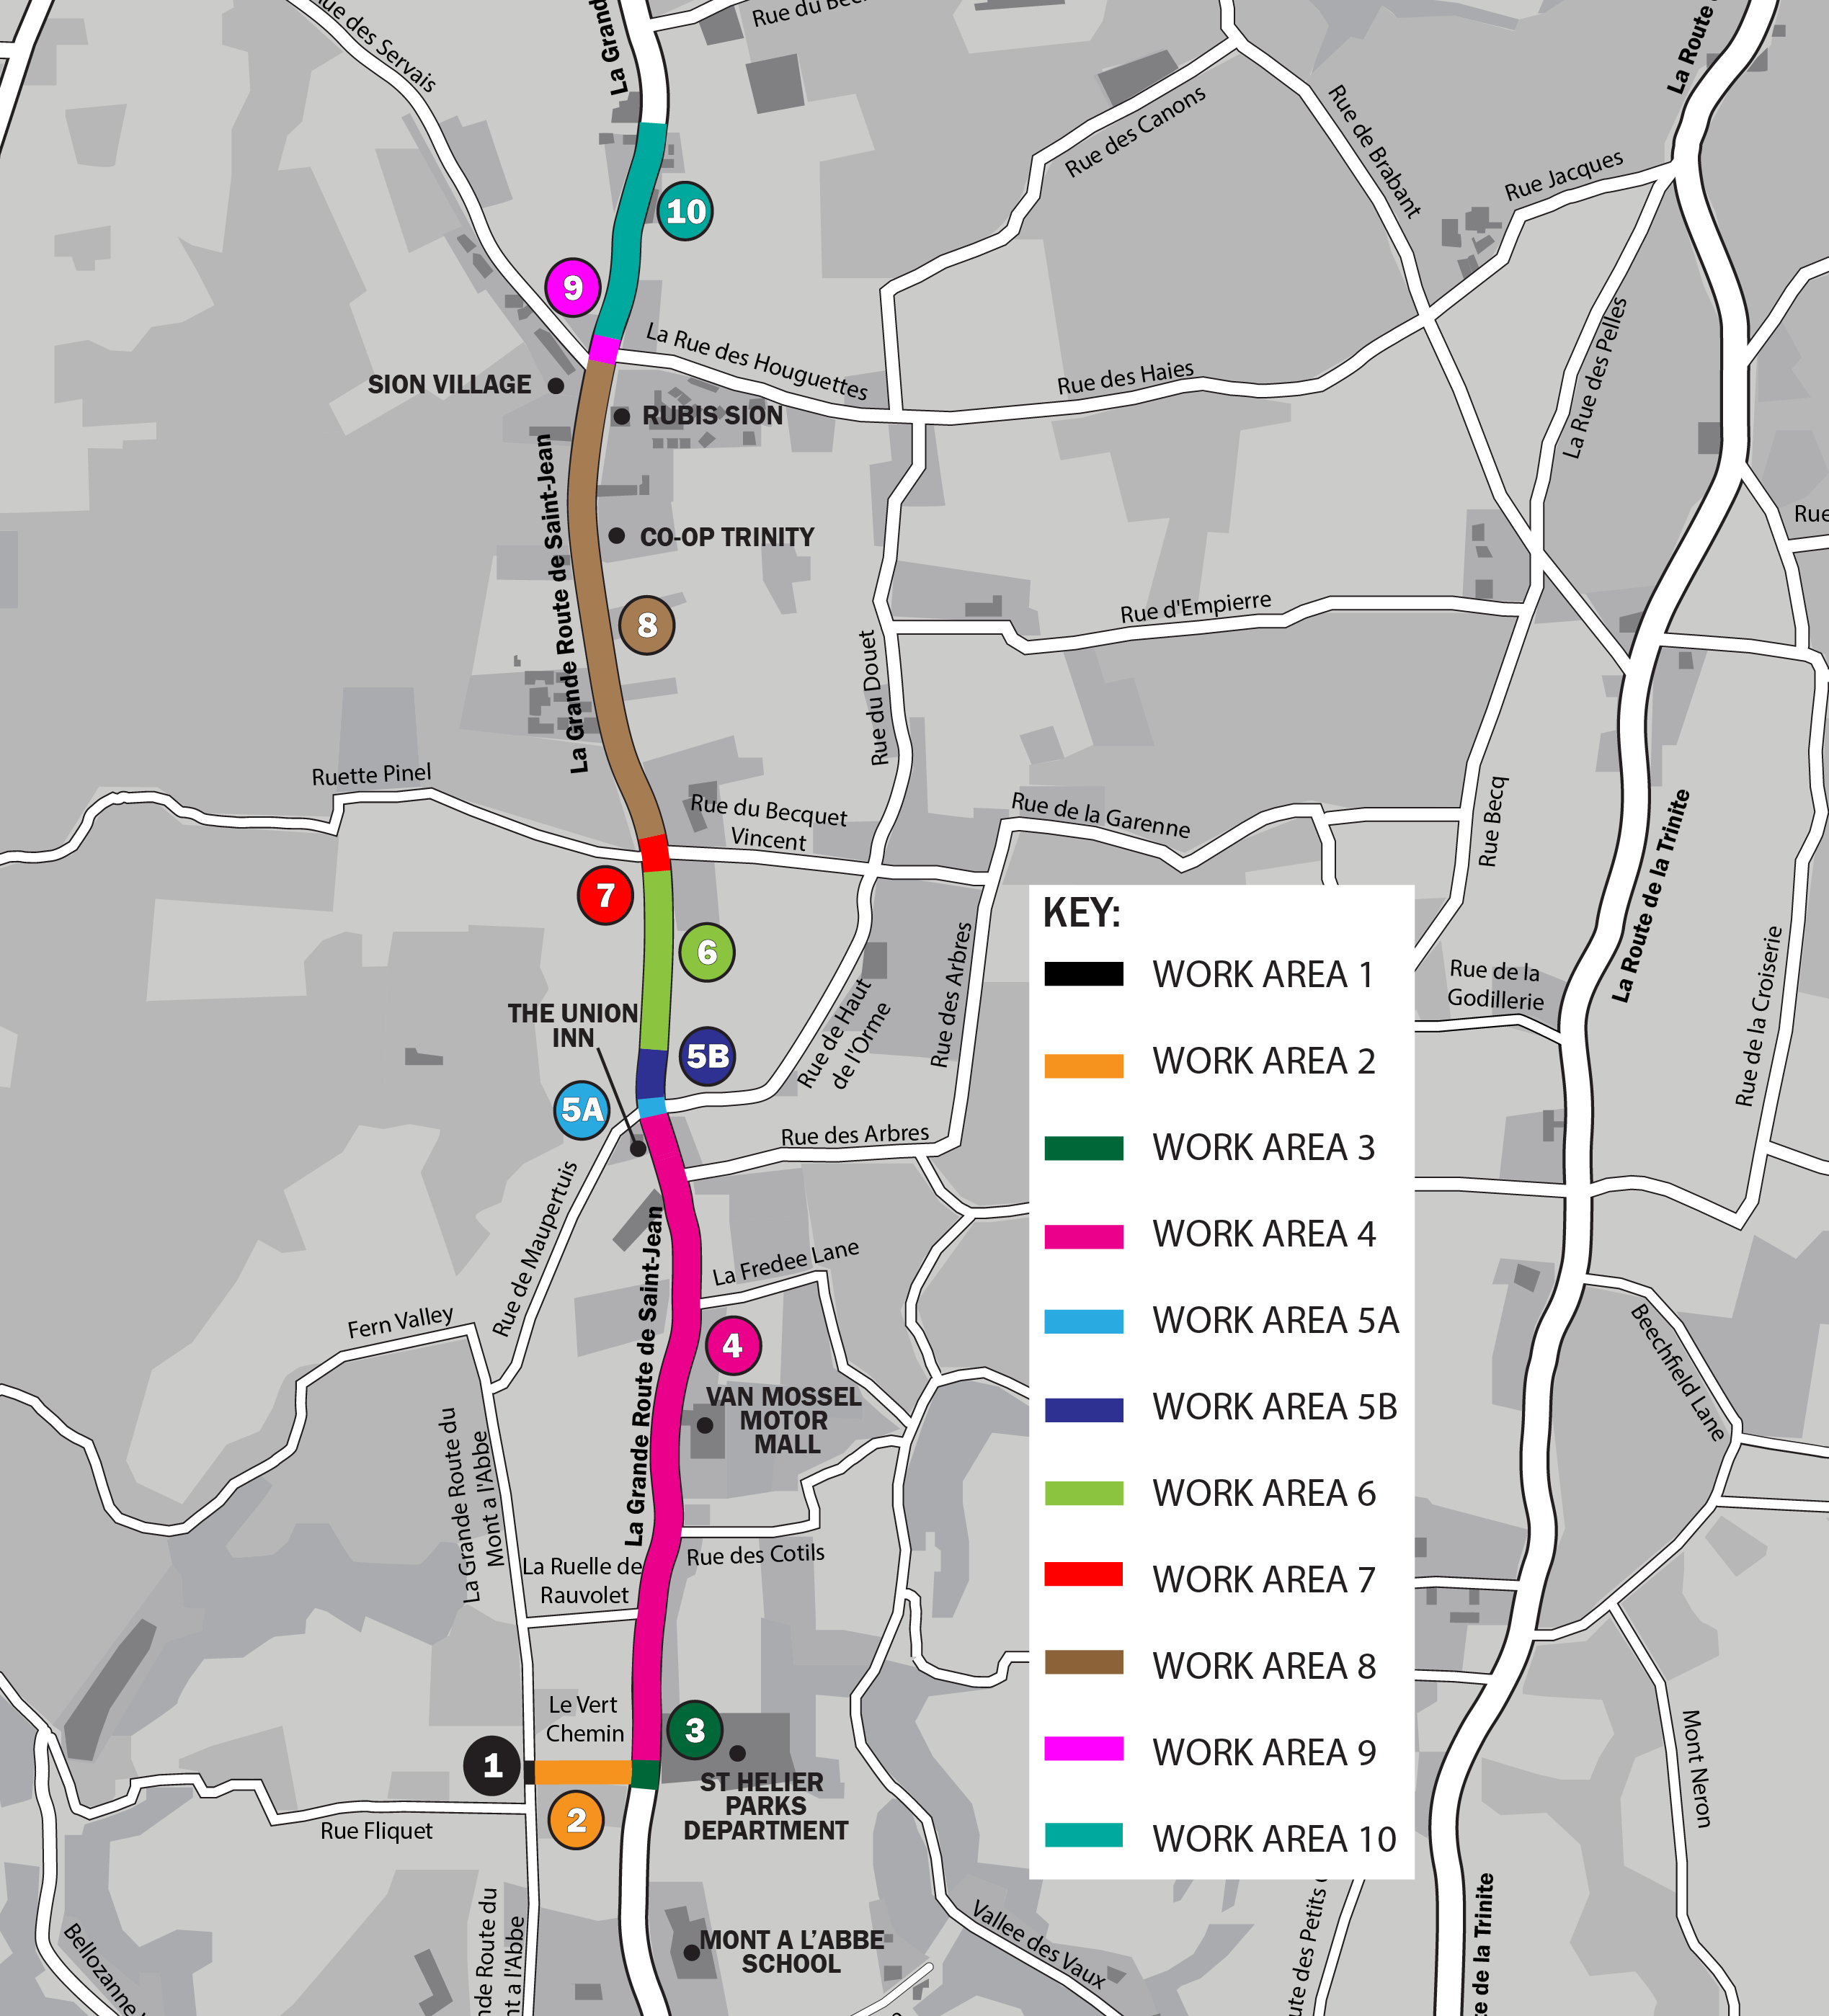
Northern Sewer Network Upgrades Phase 1
Phases 1a and 1b (approximately 2.5 km of sewer upsizing) commenced in November 2025.
Original Completion Dates: Phase 1a (3 March 2027) and Phase 1b (22 January 2027).
Weekly public communications issued to Parishes and published on the Government of Jersey Roadworks website.
Enhanced stakeholder engagement through regular progress updates and project communications.
Temporary overland water main
Phase 1b current location
Work Areas & Progress
Phase 1a:
  Works Areas 1, 2 and 3 are complete.
  Works Area 4 is in progress.
  Work Areas 5A and 5B transferred from Phase 1b.
Phase 1b:
  Works Areas 6 and 7 are complete.
  Works Area 8 is in progress.
Temporary Overland Water Main:
  Installed along the length shown in blue.
Phase 1a current location

Slide 4
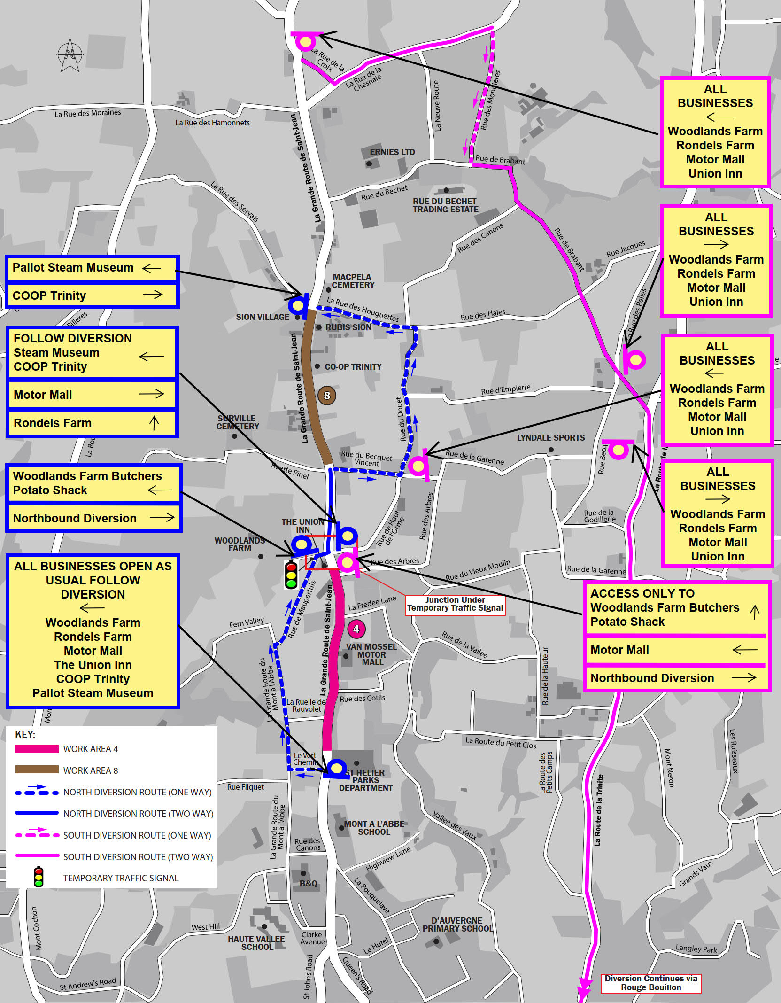
Northern Sewer Network Upgrades Phase 1
Public Communications:
Prior to construction, the project team undertook extensive public engagement through a dedicated project webpage, advertisements in the Jersey Evening Post, Parish magazines and Infrastructure and Environment social media channels, and public drop-in sessions held at St Helier, St John and Trinity Parish Halls.
Weekly Project Updates:
Weekly project updates are now published on the Government of Jersey Roadworks website to provide residents with the latest information on project progress and planned activities. (Northern sewer network upgrades)
Updates are also provided to all Parishes for onward distribution through their communication channels.
Residents can request to receive updates directly by emailing DFI@gov.je and asking to be added to the distribution list.

Slide 5
Northern Sewer Network Upgrades Phase 1
Traffic Management and Diversion Routes
Diversion routes were assessed and approved by the Highway Authority to support the safe delivery of essential infrastructure works while minimising disruption to road users.
Routes are continually monitored and adjusted where necessary to respond to changing site conditions and network requirements.
Phases 1a and 1b were undertaken concurrently to reduce the overall duration of disruption to residents, businesses and road users.
Feedback on diversion routes can be submitted through the Government of Jersey feedback service: www.gov.je/feedback
Additional signage has been installed to help maintain access and direct customers to affected businesses.

Slide 6
Northern Sewer Network Upgrades Phase 1
Phase 1a – Progress Update
Key Progress and Delivery Status
Initial delays caused by a conflict with a JEC 90kV cable and challenging hard rock ground conditions have been successfully resolved.
Construction is now progressing in accordance with the revised construction sequence.
Stakeholder and Logistics Management
Northbound diversion routes continue to support deliveries to local businesses.
Articulated HGV access is accommodated through a coordinated fortnightly access arrangement where required.
Four HGV access events have resulted in a cumulative four-day extension to the Completion Date.
The Project Team continues to actively manage access requests to minimise programme impacts.
Programme and Scope Changes
Current contractual Completion Date: 6 May 2027.
Additional sewer works (Work Areas 5A and 5B) were transferred from Phase 1b to Phase 1a.
Transfer undertaken to address:
  Jersey Electricity requirements for working adjacent to high-voltage infrastructure.
  Traffic management complexities associated with maintaining northbound bus access.
Current Performance
1020 m of 1,500 m sewer upgrade completed (approximately 68% complete).
Progress is currently tracking around three weeks ahead of the latest Accepted Programme.
Works remain on course to achieve key delivery milestones.

Slide 7
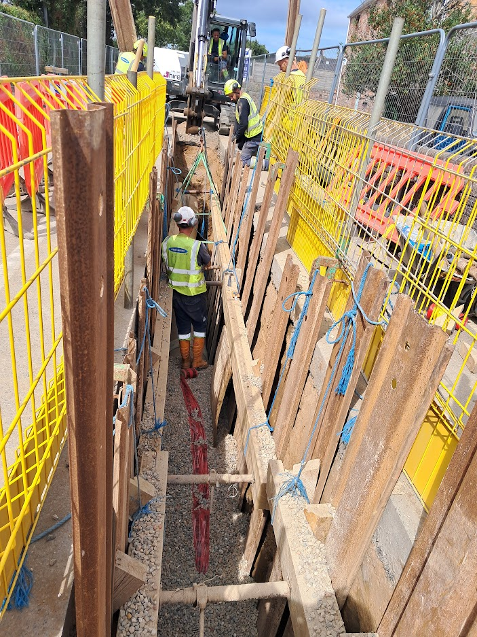
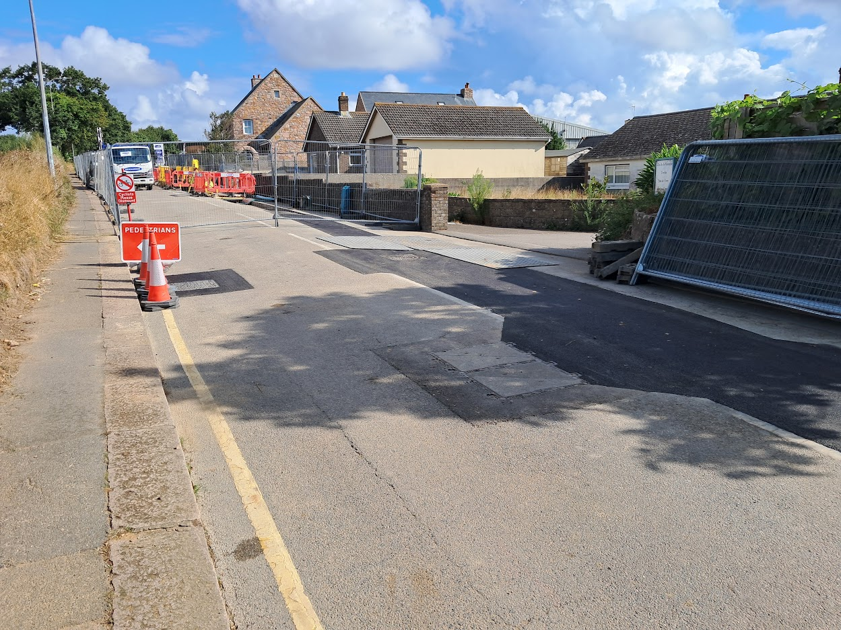
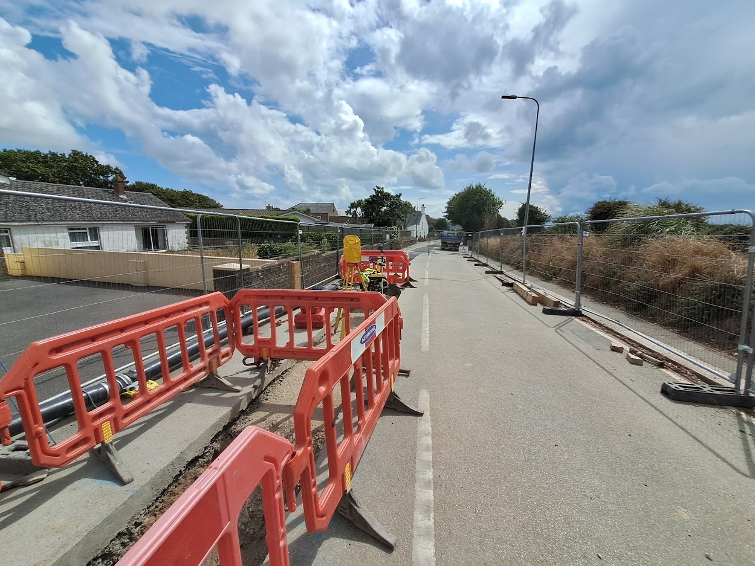
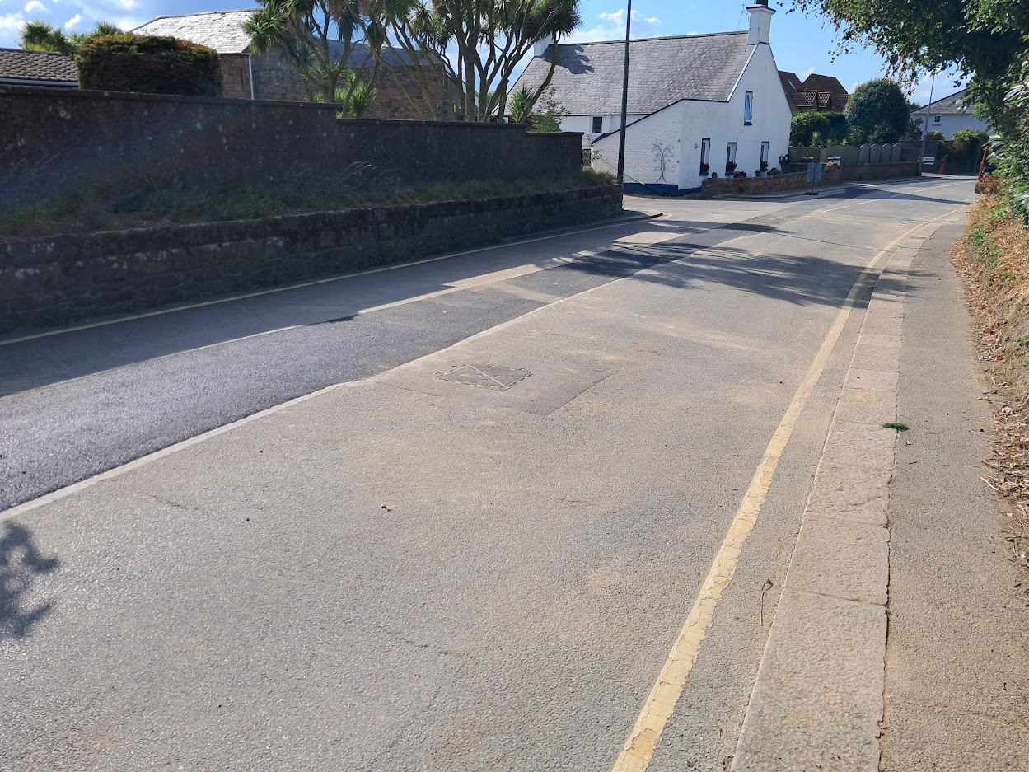
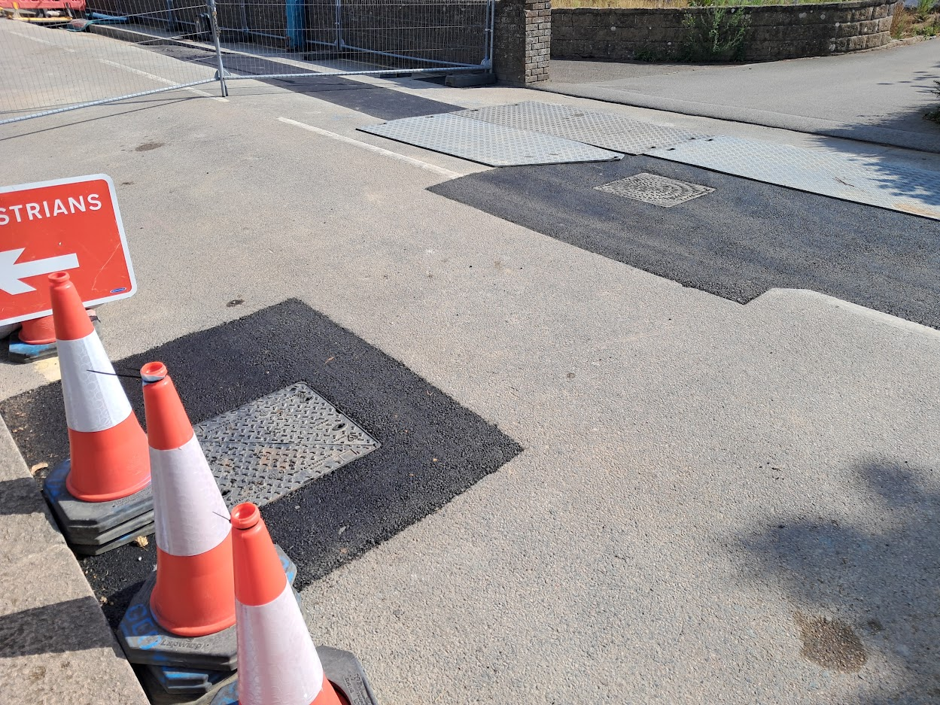
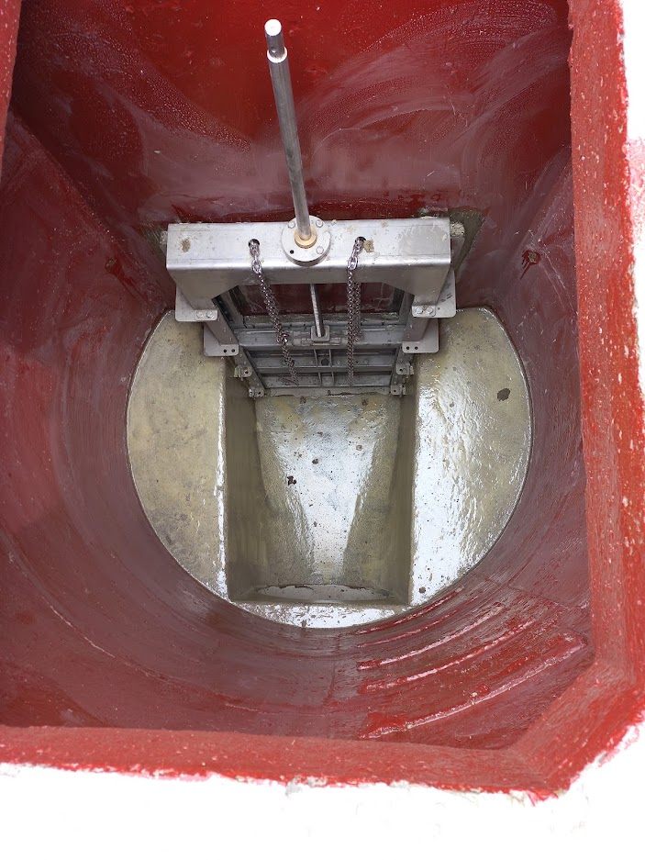
Northern Sewer Network Upgrades Phase 1a
Completed and reinstated section of works
Area within the site boundary awaiting asphalt reinstatement
Reinstated and reopened section of La Grande Route de St Jean (junction with La Rue des Cotils)
Operative working with supported trench
Additional inspection chamber replaced during the works by Drainage Operations team
New penstock flow control chamber, complete with H2S protective coating

Slide 8
Northern Sewer Network Upgrades Phase 1
Phase 1b – Progress Update
Jersey Water Infrastructure Conflict
Works between MH26 and MH27 fell approximately five weeks behind programme due to conflicts with existing Jersey Water infrastructure.
A Stop Work Order was issued on 8 May 2026 following operational concerns.
A Demobilisation Instruction was subsequently issued on 26 May 2026 to enable installation of a temporary overland water main.
Temporary Water Main Solution
Installation of the temporary water main commenced on 22 June 2026 following delivery of the required pipes and fittings.
Connection to the existing water network is scheduled for the week commencing 17 August 2026.
Following commissioning, customer supplies will be transferred to the temporary network.
Transfer activities are anticipated to take a further three weeks, with completion currently expected by 7 September 2026 (subject to confirmation).

Slide 9
Northern Sewer Network Upgrades Phase 1
Phase 1b – Progress Update (continued)
Programme Position
Current contractual Completion Date: 4 March 2027.
Approximately 480 m of the 950 m sewer upgrade has been completed (circa 50% complete).
An Extension of Time will be required to account for demobilisation and the installation and commissioning of the temporary water main.
Forecast Completion
The delay associated with the Jersey Water infrastructure conflict is currently estimated at approximately 16 weeks.
Subject to agreement of the associated Compensation Events, the forecast Completion Date is expected to move to late June 2027.
Project Team continues to work closely with Jersey Water and the Contractor to minimise further programme impacts.

Slide 10
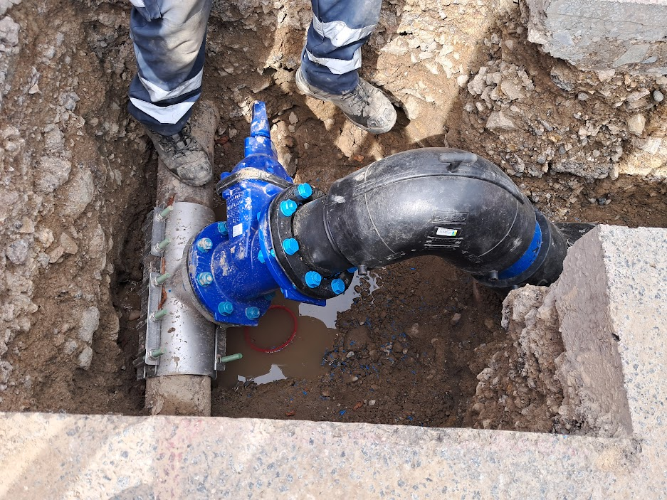
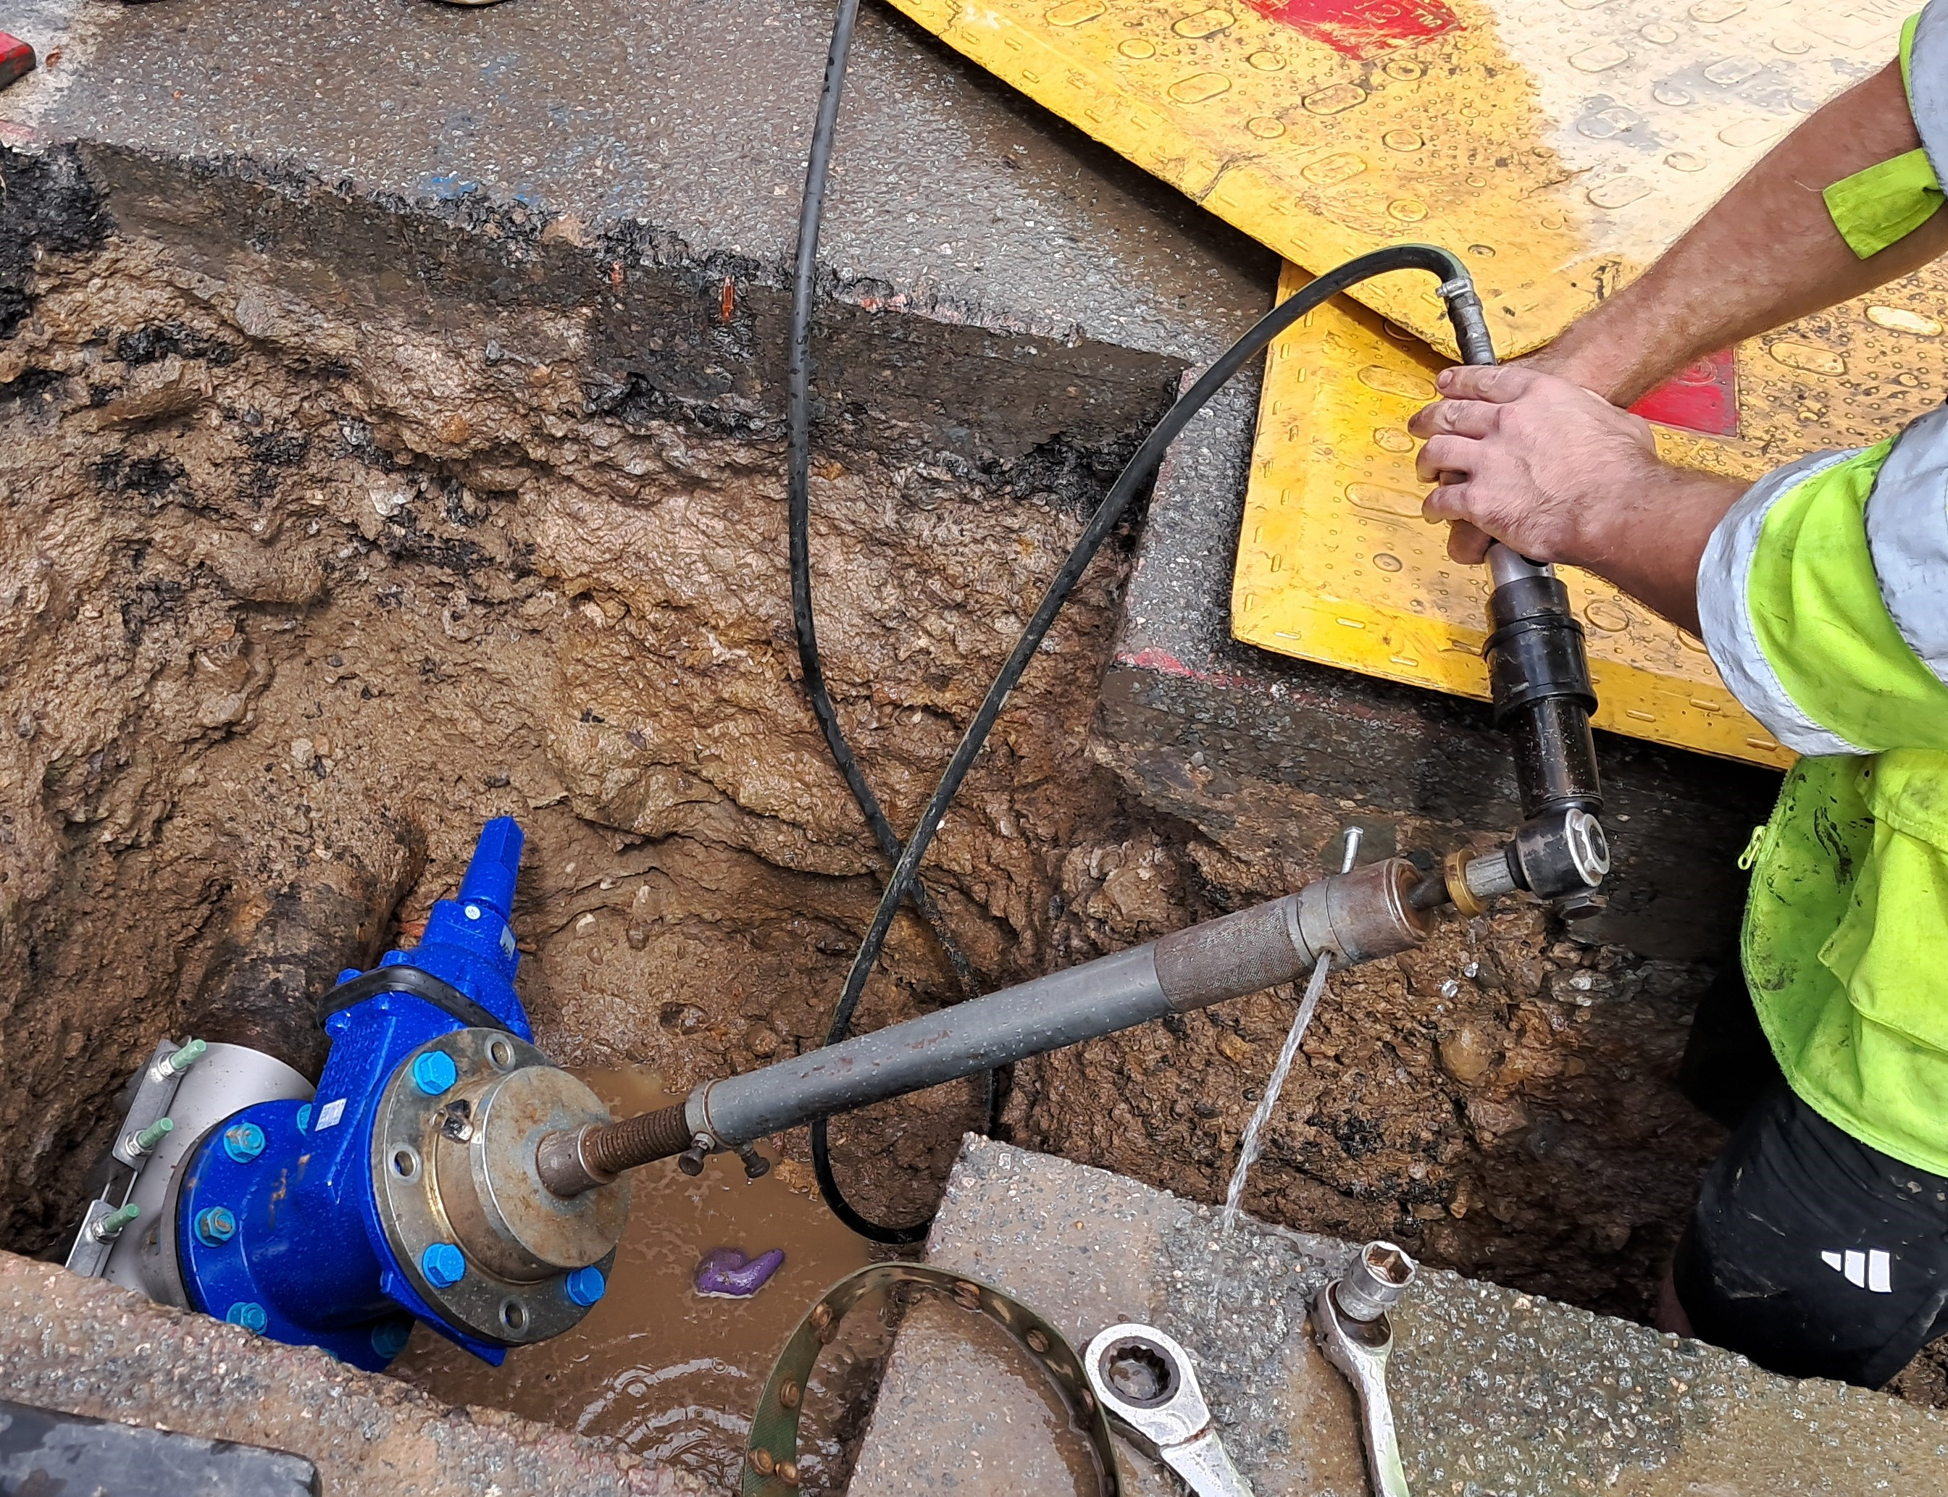
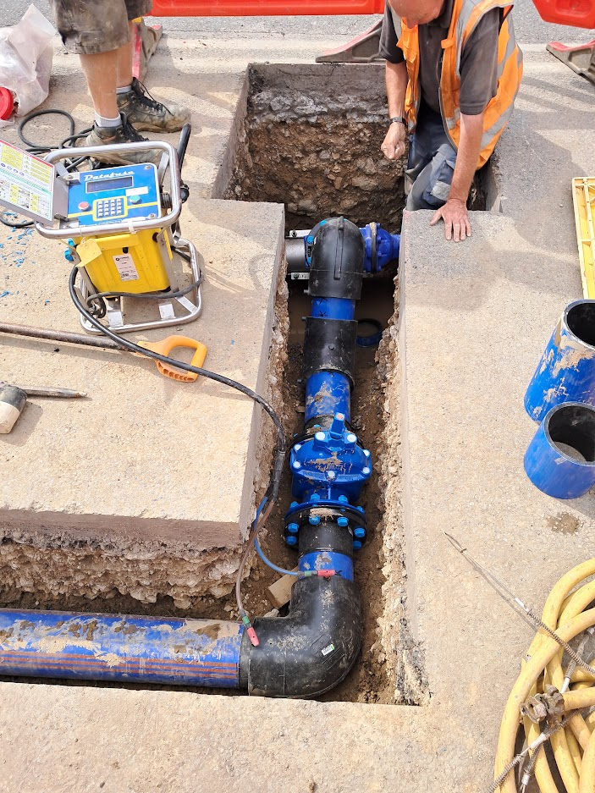
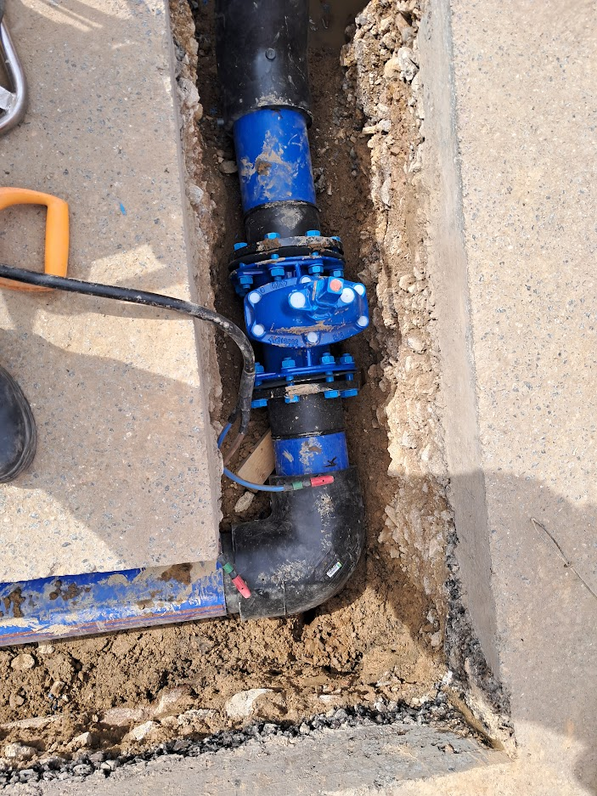
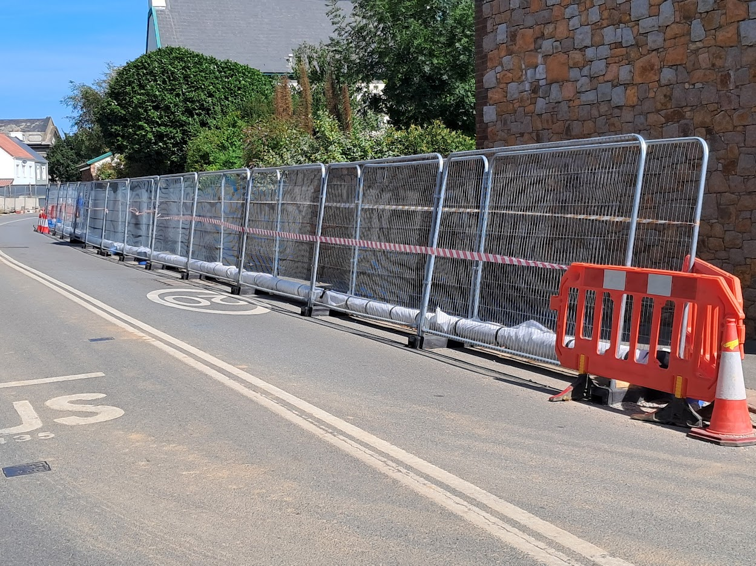
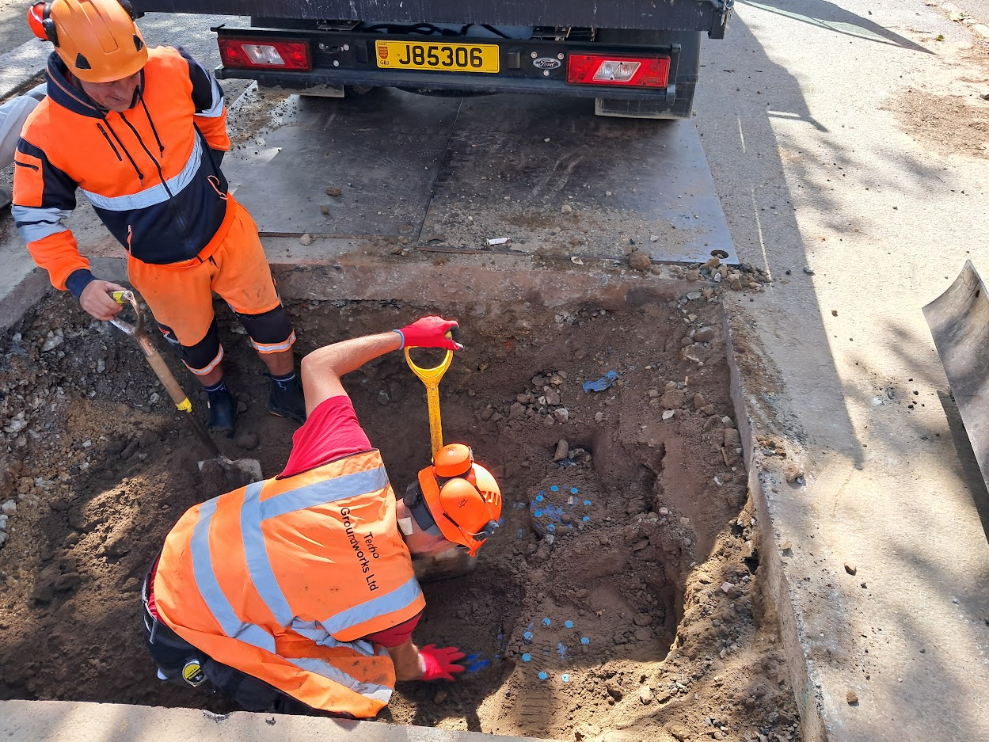
Northern Sewer Network Upgrades Phase 1b
Jayen coring into the existing water main to make the northern temporary connection
Valved connection into existing water main
Temporary water main pipe: installed and connected into existing water main at northern end of site
Commissioning valve on northern connection into existing water main
Fenced off temporary overland water main
Operatives excavating on 2no existing connections at the southern end in preparation to make connection

Slide 11
Northern Sewer Network Upgrades Phase 1
Phase 1c – Next Stage
Scope
Phase 1c represents the final stage of the Northern Sewer Network Upgrade Project.
The phase comprises approximately 1.7 km of additional sewer upsizing works required to complete the overall network upgrade.
Procurement and Funding
Procurement of Phase 1c is currently planned for Q4 2027.
Progression to procurement remains subject to the availability of funding.
Future Delivery
Phase 1c will complete the remaining strategic sewer capacity improvements within the Northern Sewer Network.
Funding requirements and programme arrangements will continue to be reviewed as part of future capital planning and budget approval processes.

Slide 12
Liquid Waste Key Infrastructure Update
Key messages:
Northern Sewer Network Upgrades:
  Phase 1a delayed from 3 March 2027 to 6 May 2027.
  Phase 1b delayed from 22 January 2027 to end of June 2027.

